Slide 1
Engaging Students in Co-Creating Curricula that Embed Equality and Diversity
Dr Pauline Hanesworth: pauline.hanesworth@heacademy.ac.uk
@HEA_EDScotland
Stephanie Millar: Stephanie.Millar@sparqs.ac.uk
@sparqs_scotland
22.10.2014

Slide 2
Agenda
This exploratory and interactive workshop will comprise:
13.00-13.30 Registration and light lunch
13.30-13.50 Welcome and introductions
13.50-14.30 The Frameworks
14.30-15.15 Identifying the Issues
15.15-15.30 Comfort break
15.30-16.15 Searching for solutions
16.15-16.30 Moving forward
Notes:
Agenda
13.00-13.30 Registration and light lunch
13.30-13.50 Welcome and introductions
13.50-14.30 The Frameworks
14.30-15.15 Identifying the Issues
15.15-15.30 Comfort break
15.30-16.15 Searching for solutions
16.15-16.30 Moving forward

Slide 3


Introductions
Presenters
Stephanie Millar, sparqs
Pauline Hanesworth, HEA
Note-taker / Observer
Anne-Marie Docherty, sparqs
Sarah Turnbull, HEA
What do you hope to get out of today?
Notes:
Introductions
Presenters
Stephanie Millar, sparqs
Pauline Hanesworth, HEA
Facilitators / Observers
Anne-Marie Doherty, sparqs
Sarah Turnbull, HEA
On your tables, please:
Introduce yourselves to each other;
Discuss what you hope to get out of today.

Slide 4
The Frameworks

Slide 5
What is sparqs and what do we do?
Stephanie Millar, Development Advisor

Slide 6
Students are able to make a positive difference to the educational experience in Scotland’s colleges and universities and benefit from this, helping shape the nature of learning and contributing to the success of Scotland’s tertiary education sector.

Slide 7
sparqs
sparqs (Student Participation in Quality Scotland) was created in 2003 and is funded by the Scottish Funding Council.
Work with:
  All colleges and HE institutions throughout Scotland.
  Students’ Associations.
  Individual students.
  Other sector agencies.

Slide 8
What we do
Training and support for student reps both within institutions and at a national level.
Support for individual institutions to enable them to develop effective structures and support for student engagement.
Support for national development of student engagement and to support students at this level.
Input into the development of student engagement through research, policy development and sharing of practice.

Slide 9
What is student engagement?

Slide 10


Slide 11


A Student Engagement Framework for Scotland
There are five key elements:
Students feeling part of a supportive institution.
Students engaging in their own learning.
Students working with their institution in shaping the direction of learning.
Formal mechanisms for quality and governance.
Influencing the student experience at national level.
The use of the term ‘learning’ throughout the framework can apply to learning, teaching and assessment.

Slide 12
A Student Engagement Framework for Scotland
There are six features of effective student engagement:
A culture of engagement.
Students as partners.
Responding to diversity.
Valuing the student contribution.
Focus on enhancement and change.
Appropriate resources and support.

Slide 13
Why is representation important?
Student
views
Dialogue
with staff
Improved learning
experience
YOU ARE THE EXPERT!

Slide 14
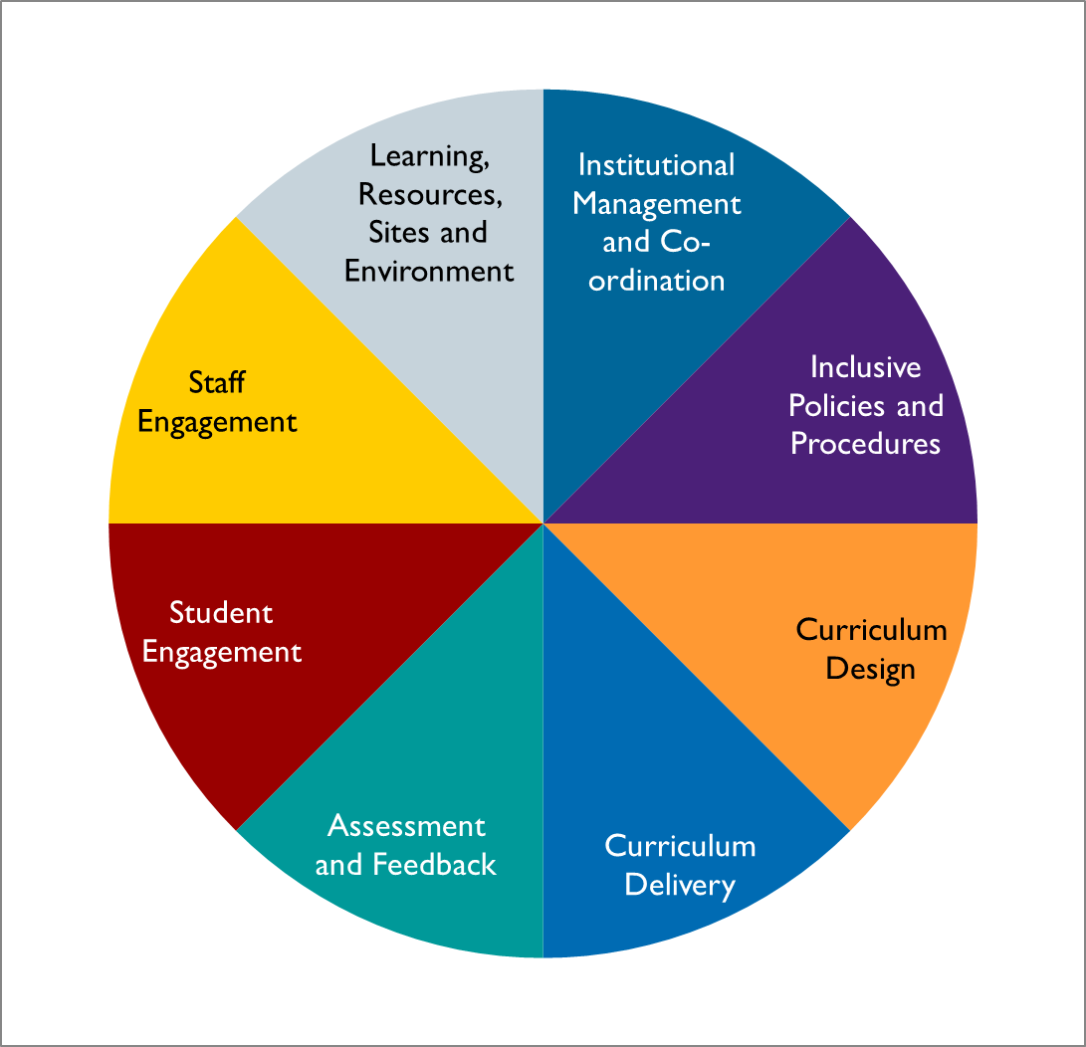
The Frameworks: Embedding Equality and Diversity in the Curriculum (EEDC)
Notes:
The Frameworks: Embedding Equality and Diversity in the Curriculum (EEDC)
The eight areas that the project is concerned about:
- Institutional Management and Co-ordination;
- Inclusive Policies and Procedures;
- Curriculum Design;
- Curriculum Delivery;
- Assessment and Feedback;
- Student Engagement;
- Staff Engagement;
- Learning Resources, Sites and Environment.

Slide 15
The Frameworks: EEDC - What
Inclusivity
Diversity Competence
Diversity Inclusivity
Understanding
Self-reflection
Exposure
Interactivity
Engagement
Ability
Belonging
15
Notes:
Embedding Equality and Diversity in the Curriculum – What
Inclusivity: Belonging, Engagement and Ability;
Diversity Inclusivity: Exposure and Understanding
Diversity Competence: Interactivity; Self-reflection

Slide 16
The Frameworks: EEDC - Why
Legalities
Eliminate discrimination etc.
Advance equality of opportunity
Retention and Success
Attainment Gaps
Graduate Attributes
Enquiry and Lifelong Learning
Aspiration and Personal Development
Foster good relations
Outlook and Engagement
Retention
Student Satisfaction
Notes:
Embedding Equality and Diversity in the Curriculum – Why
Legalities
Eliminate discrimination etc.
Advance equality of opportunity
Foster good relations
Retention and Success
Retention
Attainment Gaps
Student Satisfaction
Graduate Attributes
Enquiry and Lifelong Learning
Aspiration and Personal Development
Outlook and Engagement

Slide 17
The Frameworks: EEDC - How
Self-Reflection
Belonging and Engagement
Interactivity
Ability
Exposure and Understand-ing
Notes:
Embedding Equality and Diversity in the Curriculum – How
Belonging and Engagement
The creation of environments (physical and virtual) and learning experiences in which all students can feel like they belong, in which they are not made to feel isolated and excluded, in which they all have the opportunity to be engaged, and which, to some extent, are shaped by those students acting as partners.
Ability
The creation of environments (physical and virtual) and learning experiences in which all students are given the opportunity to reach their potential and in which no student is automatically disadvantaged by teaching practices and curricula.
Interactivity
The creation of environments (physical and virtual) and learning experiences in which students of different backgrounds, groups and identities are given the opportunity to interact with each other in a collaborative and collegial space so as to learn from each other and so as to increase their understandings of their own out groups.
Knowledge and Exposure
The creation of environments (physical and virtual) and learning experiences in which students are exposed to and are given the opportunity to expand their knowledge and understanding of many different cultures and identities in a manner appropriate to the subject being taught.
Self-Reflection
The consideration of our own identities, biases and backgrounds (academic and otherwise) in the creation of curricula and teaching experiences in order to develop our understanding of how these impact on (and how we can work with them) student learning experiences.

Slide 18
The Frameworks: EEDC and Student Engagement
1] Commitment to, and accountability for, on-going student engagement is reflected in institutional policies, procedures and practices.
2] Policies and procedures promote the on-going engagement of students in decisions about the curriculum.
3] There is a range of opportunities for students to engage in the planning, design and delivery of the curriculum.
4] Student contributions and perspectives are valued as co-contributors to the curriculum.
5] Students are provided with information, training and/or resources to enable them to carry out their engagement roles effectively.
6] A range of incentives are provided to encourage students to participate over time in the opportunities provided.
7] Students understand how their previous contributions have been used and their continued engagement is facilitated.
8] The uptake of engagement opportunities by particular student groups is monitored and evaluated.
Notes:
The Frameworks: EEDC and Student Engagement
1] Commitment to, and accountability for, on-going student engagement is reflected in institutional policies, procedures and practices.
2] Policies and procedures promote the on-going engagement of students in decisions about the curriculum.
3] There is a range of opportunities for students to engage in the planning, design and delivery of the curriculum.
4] Student contributions and perspectives are valued as co-contributors to the curriculum.
5] Students are provided with information, training and/or resources to enable them to carry out their engagement roles effectively.
6] A range of incentives are provided to encourage students to participate over time in the opportunities provided.
7] Students understand how their previous contributions have been used and their continued engagement is facilitated.
8] The uptake of engagement opportunities by particular student groups is monitored and evaluated.

Slide 19
Identifying the Issues

Slide 20


Embracing Diversity – watch your language
Andrea Cameron, Stewart Squire, Sheena Stewart, Alison Ramsay, Alison Bell
School of Social and Health Sciences, and University Secretariat in partnership with UADSA

Slide 21
Embracing Diversity – project
Graduate attributes refer to qualities, characteristics and skills that can transfer to being responsible citizens (Bowden et al, 2000)
Should this include knowledge of the Equality Act 2010?
Sports teams behavior/attitude – Facebook; Scottish Social Attitudes Survey; campaign/event; re-survey

Slide 22
Embracing Diversity – project
  Results:-n= 129 completed pre-campaign questionnaire (56% men; 44% women); n=75 completed post-campaign questionnaire (45% male; 55% female).
  60% pre-, 56% post-campaign knew there were 9 protected characteristics.
  2/3rd (69% post-campaign) said that a student who had changed their gender from male to female could use the women’s toilet.

Slide 23
Embracing Diversity – project
Responses to Scottish Social Attitude Survey questions (Abertay students significantly different on the ‘too far’ and ‘not nearly far enough’):-

Slide 24
Embracing Diversity – project
Responses to Scottish Social Attitude Survey questions (Abertay students significantly less likely to say that Equal Opps had gone ‘too far’):-

Slide 25
Embracing Diversity – project
Responses to Scottish Social Attitude Survey questions (Abertay students significantly different in their responses):-

Slide 26
Embracing Diversity – project
SSAS Question - Do you think attempts to give money to specific organisations to help people find work is bad/very bad use of Government money (Abertay students significantly less likely to say that this was the case for BME; but significantly more likely to say bad spend for gay/lesbian and for those with depression)?

Slide 27
Embracing Diversity – project
  Next stages
  Extend campaign and build more resources
  Extend outreach work linking Abertay sport teams with community organisations with protected characteristics.
  Development of Elective module‘Ethical Reasoning for a Global Society’ featuring case studies/debates
  Key engagement aspects
  ‘Right’ events/finding your opportunity; going to the students

Slide 28

Engaging Initial Teacher Trainee (ITT) students in Co-creating curricular that embed equality and diversity (pre and post entry to the ITT programme)
Presented by : Maxwell Ayamba, Jenson Grant and Maxine Greaves MBE

Slide 29


Stimulus
"Education is about the students constructing their own knowledge ..... Self belief is supported as a key attribute in motivation "
Yorke and Knight (2004)

Slide 30

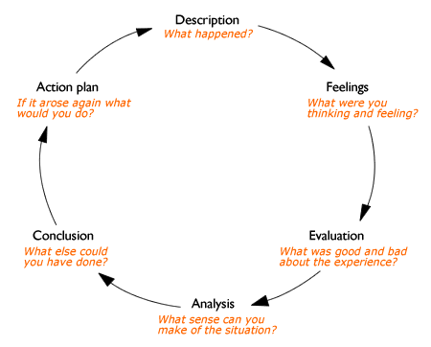
Reflection:
Gibbs (1988)

Slide 31

California State University Dominguez Hills
Critical Race Studies and Intersectionality

Slide 32
The Learning Intervention
Aims of the module:
Understand CRT better and consider its application to various dimensions of social work practice;
Examine own biases in order to embark on social work practice that is critical of discrimination and oppression of underserved populations.
Engaging Students in Co-Creating Curricula that Embed Equality and Diversity:
Co-facilitation of a class;
Personal narrative;
Social action project.

Slide 33
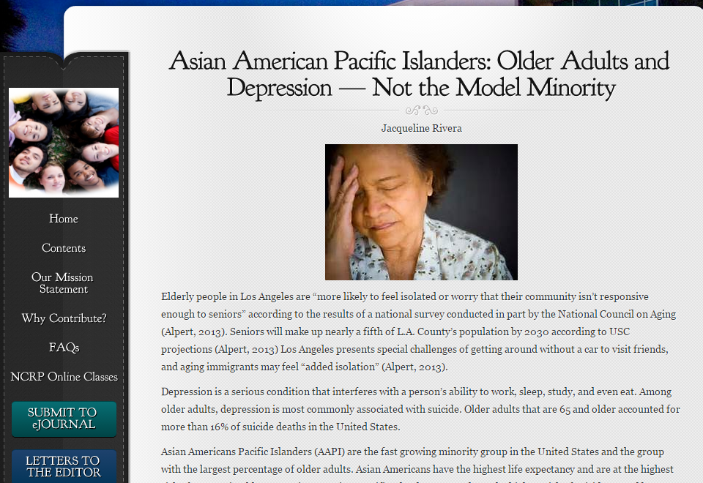

Slide 34
Implications
Engaging Students:
Ownership of course
Content of course
Peer learning
Resources:
Utilising staff and student knowledge and understanding
Challenges:
Scope and design of action based project
Development:
Co-facilitation co-creation

Slide 35
Identifying the Issues: Group Discussion
Please explore:
What are the key strategies/methods, limitations/barriers and benefits to engaging students in co-creating curricula that embed equality and diversity?
Please decide on:
Five key areas, issues and/or strategies that you would like to explore further after the break.

Slide 36
Searching for Solutions

Slide 37
Searching for Solutions: Brainstorming
Concentrating on your chosen problem/barrier/issue or strategy: what should be the future arrangements for achieving engagement of students in co-creating curricula that embed equality and diversity?
You might want to consider:
What are the implications of your chosen problem/barrier/issue or strategy?
How can we either (depending on area chosen) a. work around the problem/barrier/issue or b. implement the strategy?
What do we need from a. students, b. staff, c. the institution to enable the solution/implementation?
What resources do we need for the solution/implementation?

Slide 38
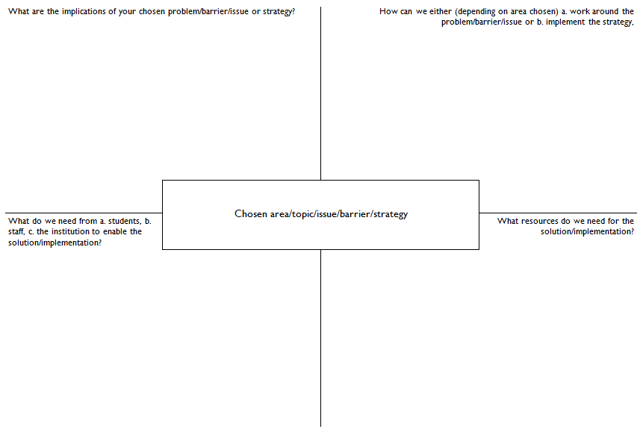
Searching for Solutions

Slide 39
Wrap Up

